Slide 1
Colloquial Expressions Detection Using Machine and Deep Learning Techniques
Mahir Faisal Chowdhury
Id: 19301026
Course: CSE431
Section: 1
Team: 2
St: Farah Binta Haque
Ra: Humaion Kabir Mehedi
Submitted to -
Annajiat Alim Rasel
‹#›

Slide 2
Introduction
What is colloquial expression?
Slang
Abbreviations
Dataset
Machine Learning Model
Naive Bayes
SVM
Random Forest
Deep Learning
BERT
Performance of Models

Slide 3
Literature Review
The research aims to improve translations of idiomatic expressions using contextual embeddings and innovative approaches, contributing to the field by introducing new methods, evaluation strategies, and implications for future research.
Some researchers proposed a frameworks which combines contrast learning and curriculum learning to detect idioms usage recognition and metaphor detection. Where they used six different datasets to evaluate their models effectiveness.
and their model specifically gives better results for smaller datasets.
The paper introduces a deep learning framework for automatic slang detection and identification, achieving robust performance and contributing to the field of natural language processing.
This paper presents a feature-based approach to multilingual idiomaticity detection, achieving improved results over the baseline and providing insights into the strengths and limitations of the model.

Slide 4
Methodology
Collected Dataset
Preprocessed Dataset
Trained by Models
Machine Learning
Naive Bayes
SVM
Random Forest
Deep Learning
BERT
Evaluate and Visualize

Slide 5
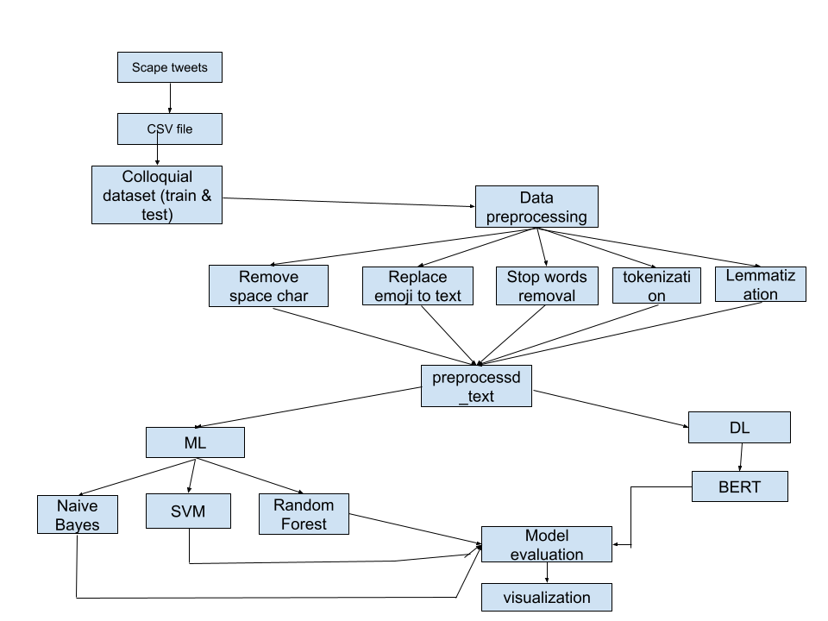
Methodology

Slide 6
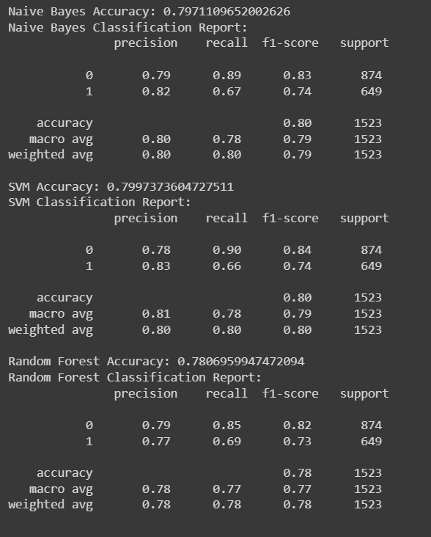
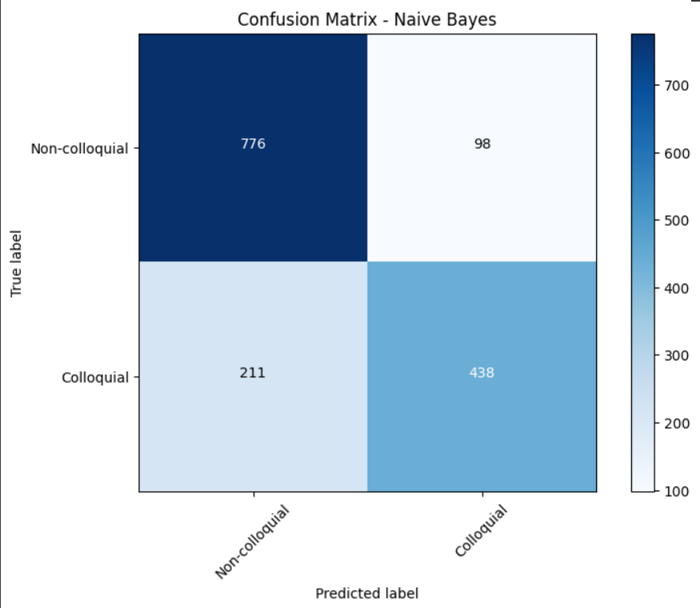
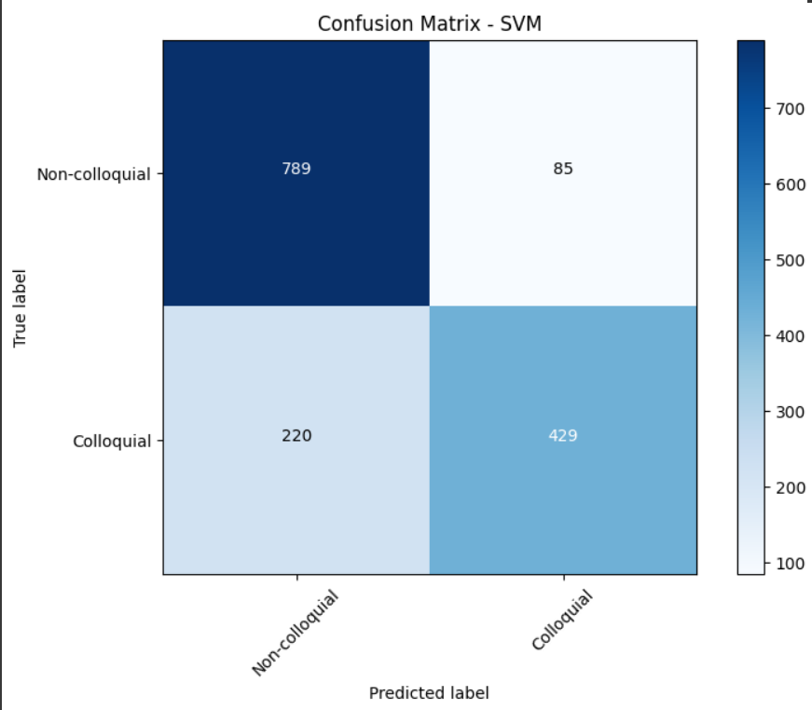
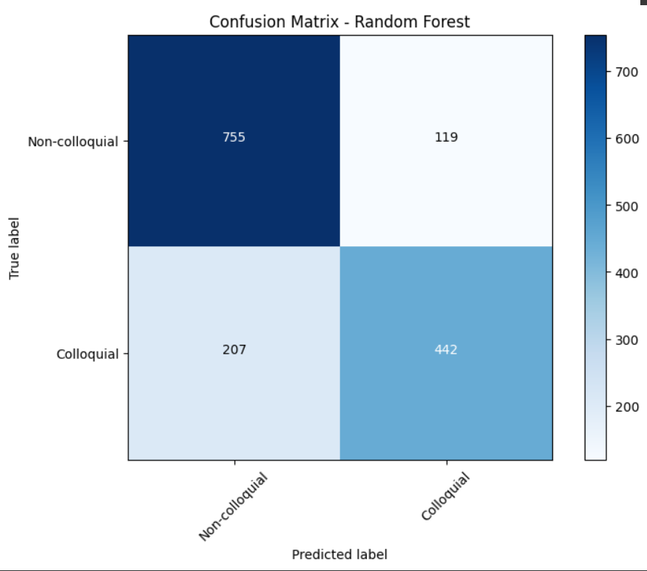
Result Analysis

Slide 7
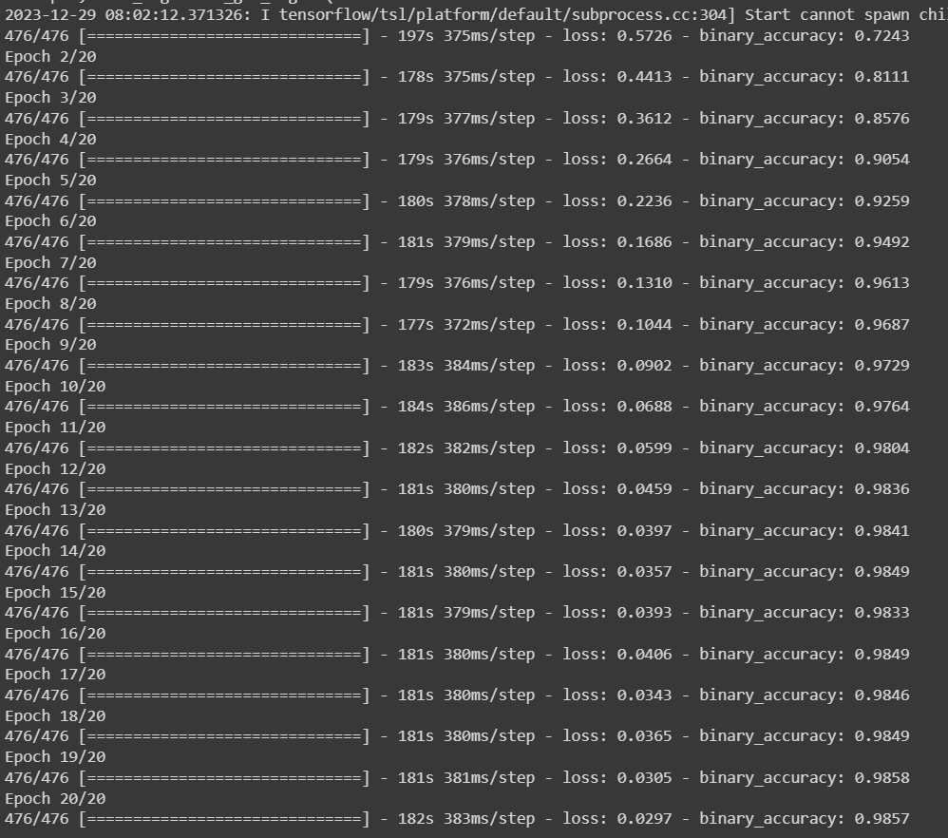
Result Analysis

Slide 8
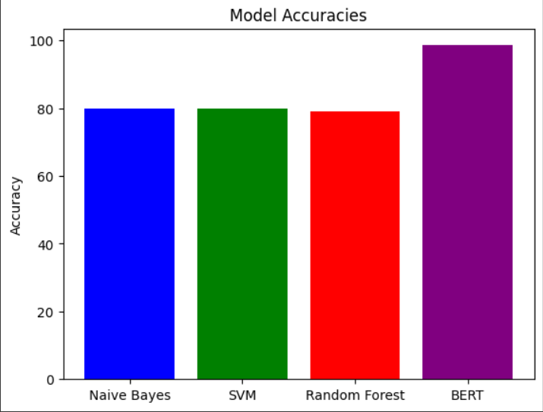
Result Analysis

Slide 9
Thanks

